Slide 1
TRC Calls to Action
By
David Perley

Slide 2
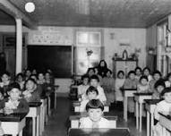
TRC Calls to Action
“It is time to commit to a process of reconciliation. By establishing a new and respectful relationship, we restore what must be restored, repair what must be repaired, and return what must be returned.” (page 6)

Slide 3
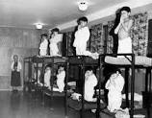
TRC Calls to Action
“Reconciliation is about establishing and maintaining a mutually respectful relationship between Aboriginal and non-Aboriginal peoples in this country.” (page 6)

Slide 4
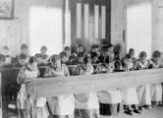
TRC Calls to Action
“In order for that to happen, there has to be awareness of the past, acknowledgement of the harm that has been inflicted, atonement for the causes, and action to change behavior.” (page 6 and 7)

Slide 5
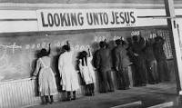
TRC Calls to Action
“Reconciliation must inspire Aboriginal and non-Aboriginal peoples to transform Canadian society so that our children and grandchildren can live together in dignity, peace, and prosperity on these lands we now share.” (page 8)

Slide 6
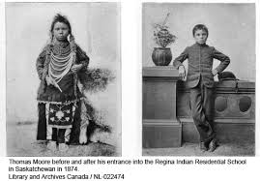
TRC Calls to Action
“We are all Treaty people. History plays an important role in reconciliation; to build for the future, Canadians must look to, and learn from, the past.” (page 8)

Slide 7
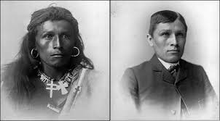
TRC Calls to Action
“Aboriginal peoples have an important contribution to make to reconciliation. Their knowledge systems, oral histories, laws, and connections to the land have virtually informed the reconciliation process to date, and are essential to its ongoing progress.” (page 9)

Slide 8
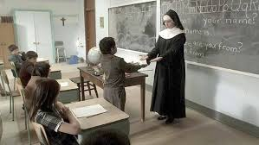
TRC calls to Action
“Without truth, justice, and healing, there can be no genuine reconciliation. Reconciliation is not about ‘closing a sad chapter of Canada’s past,’ but about opening new healing pathways of reconciliation that are forged in truth and justice.” (page 12)

Slide 9
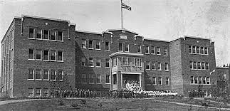
TRC Calls to Action
“…. to meet and explore the United Nations Declaration on the Rights of Indigenous Peoples, as the framework for reconciliation in Canada. We remain convinced that the UN Declaration provides the necessary principles, norms, and standards for reconciliation to flourish in twenty-first-century Canada.” (page 21)

Slide 10
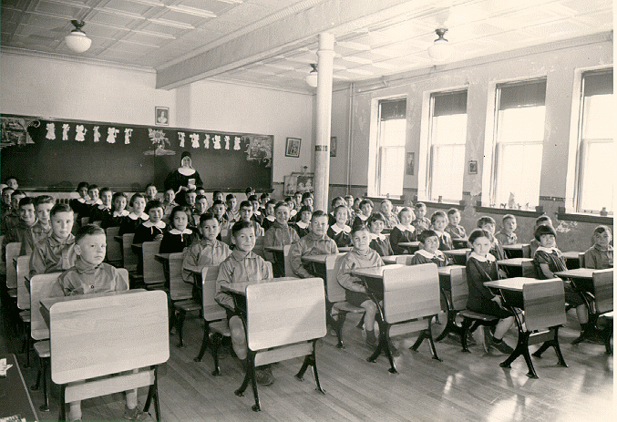
TRC Calls to Action
Section 7 of NB Education Act
Objective 6 of 10 Year Education Plan
ASD-West Wabanaki Education Policy
Tuition Agreements with Wolastoqey First Nations
School Initiatives

Slide 11
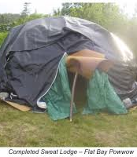
TRC Calls to Action
Circle of Understanding Sessions
Teacher In-Service
Wolastoqey Language in Schools
Wolastoqi Teacher Recruitment
Treaty Day, Orange Shirt Day
District-Based Wabanaki Education Conference

Slide 12
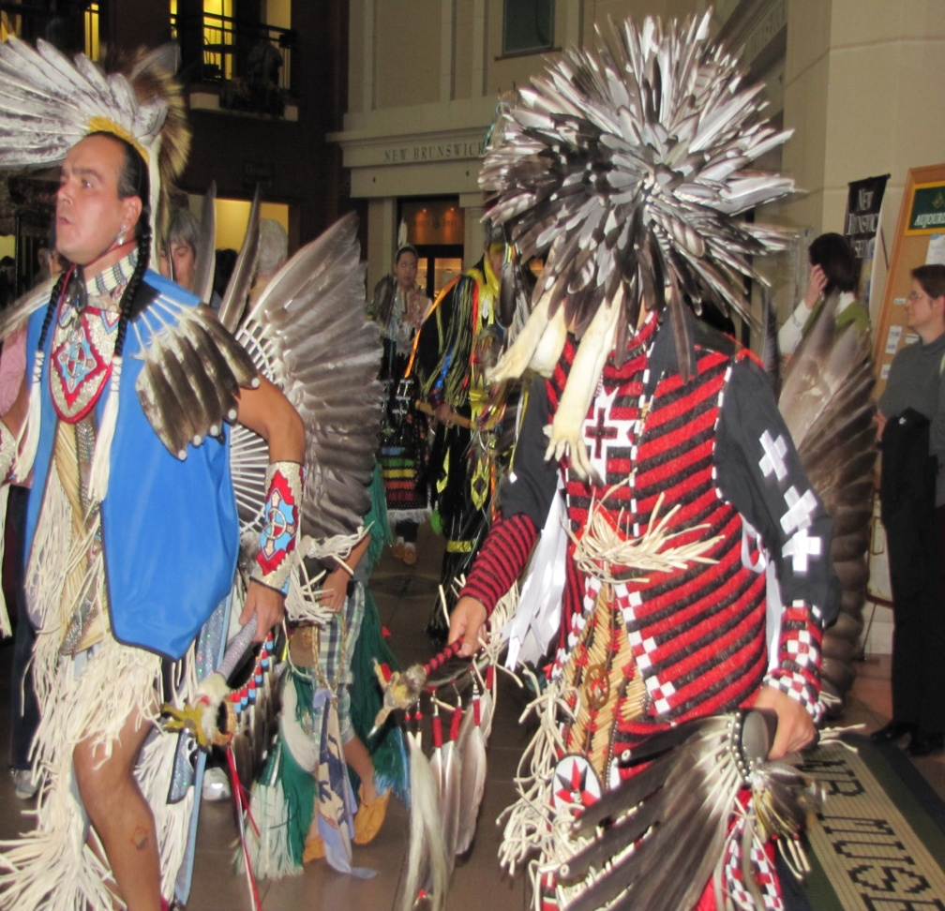
TRC Calls to Action
Woliwon!
Wela’lin!
Merci!
Thank you!
Email; dperley@unb.ca
Phone; 447-7322

